Slide 1
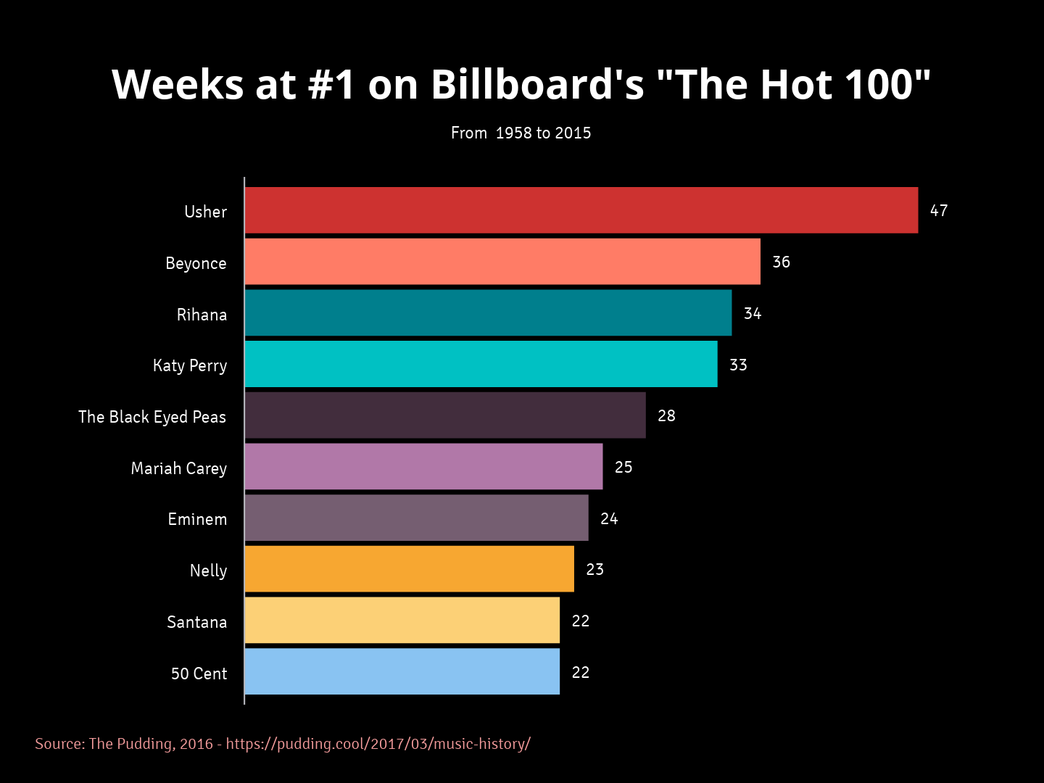
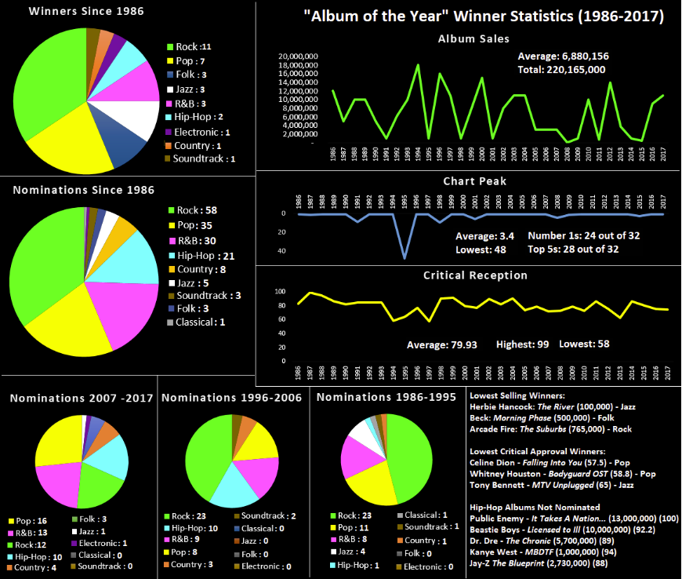
Billboard Hot or Not ?
Predicting a song’s appearance on the Billboard Hot 100
By
Md Zeeshan Arif

Slide 2

Airplay
2) Social media and streaming
3) Album sales

Slide 3
Data:
Data of around 4000 songs collected from:
billboard.com
Million song datasets

Slide 4
Audio Features:
Audio features of each song extracted from Spotify Api:
Acousticness: probability from 0.0 to 1.0 the track is acoustic
Danceability: consistency of tempo and rhythm
Valence:mood (e.g. happy, cheerful, sad, angry)
Energy: dynamic range, onset rate, timbre, loudness, general entropy
Instrumentalness: probability track contains no vocals
Liveness: presence of audience (claps and yells)
Loudness: relative average decibel level across track
Speechiness: above 0.66 entirely of spoken words
Key: pitch class 0-11
Mode: major (1), minor (0)
Tempo: beats per minute Duration in milliseconds

Slide 5
EDA AND DATA PREPROCESSING:
Removing the outliers
Duplicate items need to be remove
Distributions of all data points using various plots
Plotting songs features with respect to time
Features with features correlation

Slide 6
Models and methods:
Stratified Train/Test Split - 75/25 class balance
we have to apply different supervised machine learning algorithm to predict whether the song hit the billboard or not?, since it is a classification problem.
Logistic Regression
Gaussian discrimination Analysis (GDA)
Support Vector Machine (SVM)
Decision Tree
Neural Network

Slide 7
Which model performs better?
Compare the accuracy of each models.
Both train and test accuracy should be compare
With histogram we can compare the performance
With different condition like year of song, months etc.

Slide 8
Model testing:
. After building the model we need to evaluate our model with performance matrics like:
1) Precision
2) recall
3) f1 score
4) Roc-Auc curve
5) Confusion matrix
6) Accuracy of each model

Slide 9
Hyperparameter tuning:
1) we can tune our models with hyperparameter tuning using grid search cv or randomized search cv
2) After getting best parameter we can again put the best parameter and get the accuracy or performance of model

Slide 10
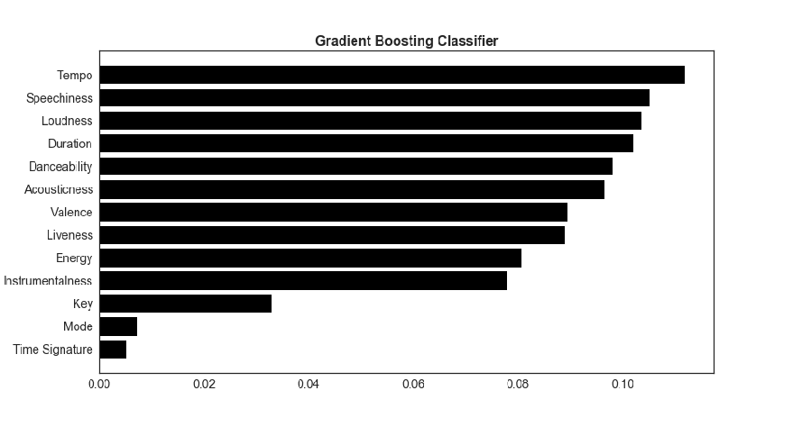
Feature Importance

Slide 11
Saving the model:
. After training and testing the data ,
we can save our model
. We can use either pickle or joblib library to save our model

Slide 12
Model Deployment:
. For deployment we need following files:
1) one app.py file
2) html file in a separate folder
3) using flask we can deploy our project in our local host.
4)we can test our app by providing features of any song , our model will predict whether the song is hit or not

Slide 13
Final Thoughts
How does popular taste change over time?
More data and granular features needed

Slide 14
THANKS!

